Slide 1
Sociology Course Code (SS 2005)
Muhammad Zeeshan

Slide 2
SOCIAL INTERACTION AND SOCIAL ACTION
Social Interaction, the process by which people act and react in relation to others.
It is the basic building block of a human society. Without social interaction there is no exchange of information and feelings among humans.
Social Action, any action performed for achieving a specific goal. e.g. students studying to secure good grades, driving a car, reaching home etc.
Social Interaction and Social Action are both important concepts in understanding the dynamics of human interaction in society.

Slide 3
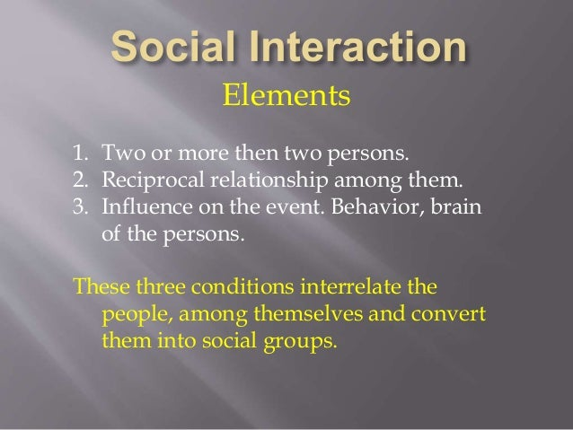

Slide 4
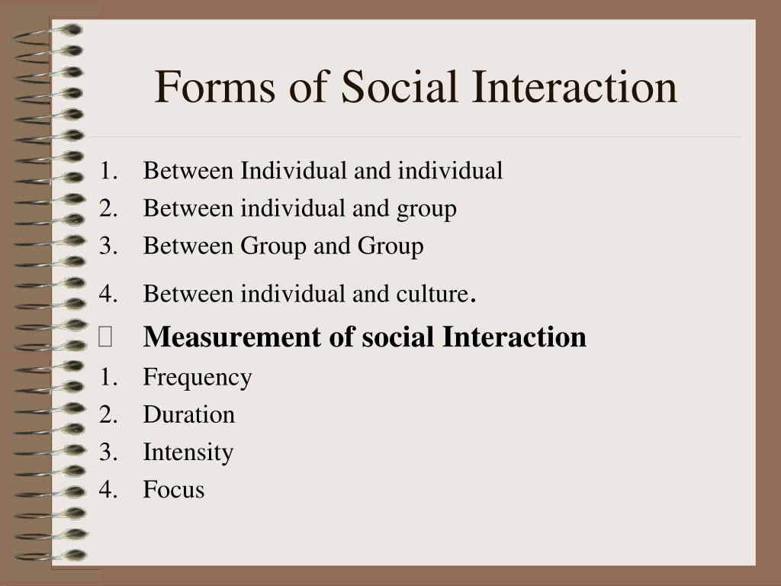

Slide 5
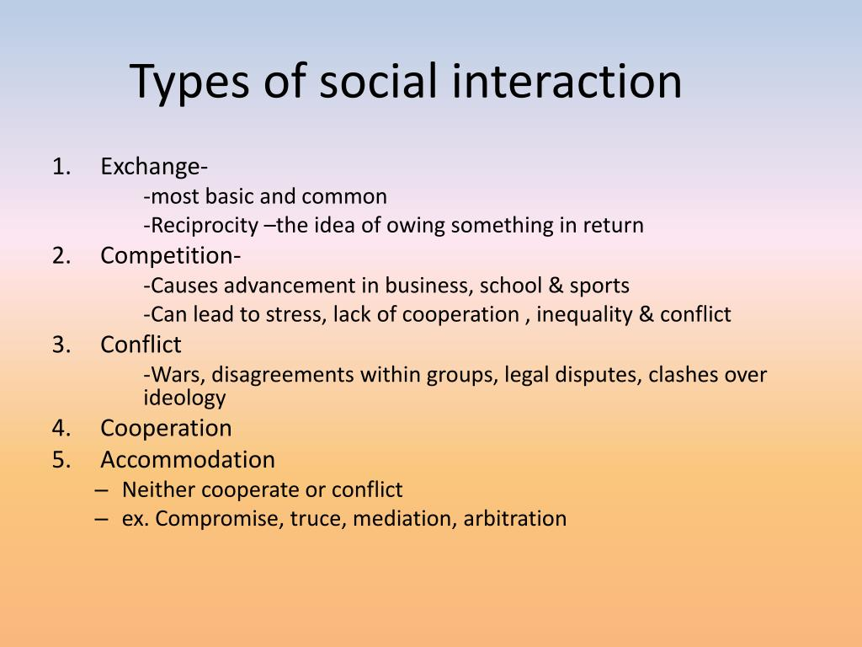

Slide 6
SOCIAL STATUS AND RELATED CONCEPTS
Status, a social position that a person holds. In everyday use, the word status generally means “prestige,”
The term status set refers to all the statuses a person holds at a given time. e.g. A teenage girl may be a daughter to her parents, a sister to her brother, a student at her school, and a goalie on her soccer team.
An ascribed status is a social position a person receives at birth or takes on involuntarily later in life. e.g. Caste, Gender, Race etc.
An achieved status refers to a social position a person takes on voluntarily that Understand reflects personal ability and effort. E.g. Skills, Education, Power, Respect.
Some statuses matter more than others. A master status is a status that has special importance for social identity, often shaping a person’s entire life.

Slide 7
SOCIAL ROLE AND RELATED CONCEPTS
Role, behavior expected of someone who holds a particular status. A person holds a status and performs a role
Robert Merton (1968) introduced the term role set to identify a number of roles attached to a single status
Role conflict as conflict among the roles connected to two or more statuses.
Role strain refers to tension among the roles connected to a single status

Slide 8
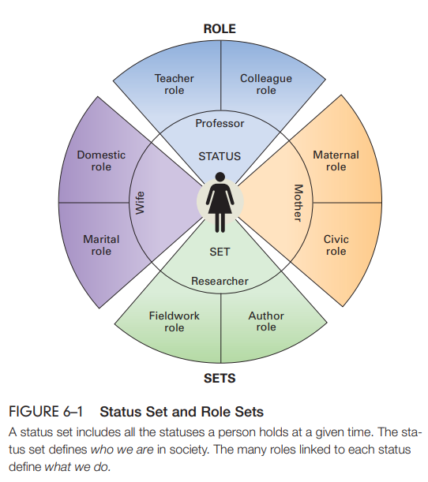

Slide 9
IMPORTANT CONCEPTS
The social construction of reality is the process by which people creatively shape reality through social interaction. This idea is the foundation of the symbolic-interaction approach
Thomas theorem, named after W. I. Thomas and Dorothy Thomas says that Situations that are defined as real are real in their consequences.
Harold Garfunkel (1967) devised ethnomethodology, the study of the way people make sense of their everyday surroundings

Slide 10
ERVING GOFFMAN’S: DRAMATURGICAL ANALYSIS
Erving Goffman (1922–1982) was another sociologist who analyzed social interaction, explaining that people live their lives much like actors performing on a stage.
If we imagine ourselves as directors observing what goes on in the theater of everyday life, we are doing what Goffman called dramaturgical analysis, the study of social interaction in terms of theatrical performance.
Dramaturgical analysis offers a fresh look at the concepts of status and role.
A status is like a part in a play, and a role serves as a script, supplying dialogue and action for the characters. Goffman described each individual’s “performance” as the presentation of self, a person’s efforts to create specific impressions in the minds of others.
This process, sometimes called impression management, begins with the idea of personal performance (Goffman, 1959, 1967).

Slide 11
Non-Verbal Communication, Demeanor, Personal Spcae
Nonverbal communication, communication using body movements, gestures, and facial expressions rather than speech. People use many parts of the body to convey information through body language.
Facial expressions are the most important type of body language.
Demeanor—the way we act and carry ourselves—is a clue to social power. Simply put, powerful people enjoy more freedom in how they act
For both sexes, the concept of personal space refers to the surrounding area over which a person makes some claim to privacy

Slide 12
Q&A Session

